Slide 1

The Turing test
6droids
14208971 Tharkana D Kodagoda
14208893 Sahitha Nelanga H De Silva
14208910 H W Srimal Priyanga Fonseka
14209059 Dilina Namal Weerasinghe
14209074 P W Poorni Yasodara
14209759 Kavindu Yudeesha Lakshan Narathota

Slide 2
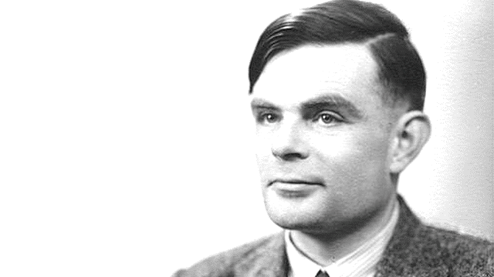
What is a Turing test?
Computer is deemed to have artificial intelligence if it can mimic human responses under specific conditions. In Turing's test, if the human being conducting the test is unable to consistently determine whether an answer has been given by a computer or by another human being, then the computer is considered to have "passed" the test.
Alan Turing
1912 - 1954
Notes:
Turing Test is a method for determining whether or not a computer is capable of thinking like a human.

Slide 3

What does an Ai needed to pass the Turing test
Natural language processing
To understand the questions
Knowledge representation
To store what we know
Automated reasoning
To act on its knowledge
Machine learning
To adapt to changing circumstances

Slide 4

Turing test (Example)
Hi
I’m Bob!
I’m a mathematician and I’m focusing on AI
Notes:
This is bob and he’s a mathematician who’s working on AI

Slide 5

?
?

Slide 6


?
?

Slide 7


Slide 8
The Turing Test Measures Something,
But It’s Not “Intelligence”
-Dan Falk (smithsonianmag.com)

